Slide 1
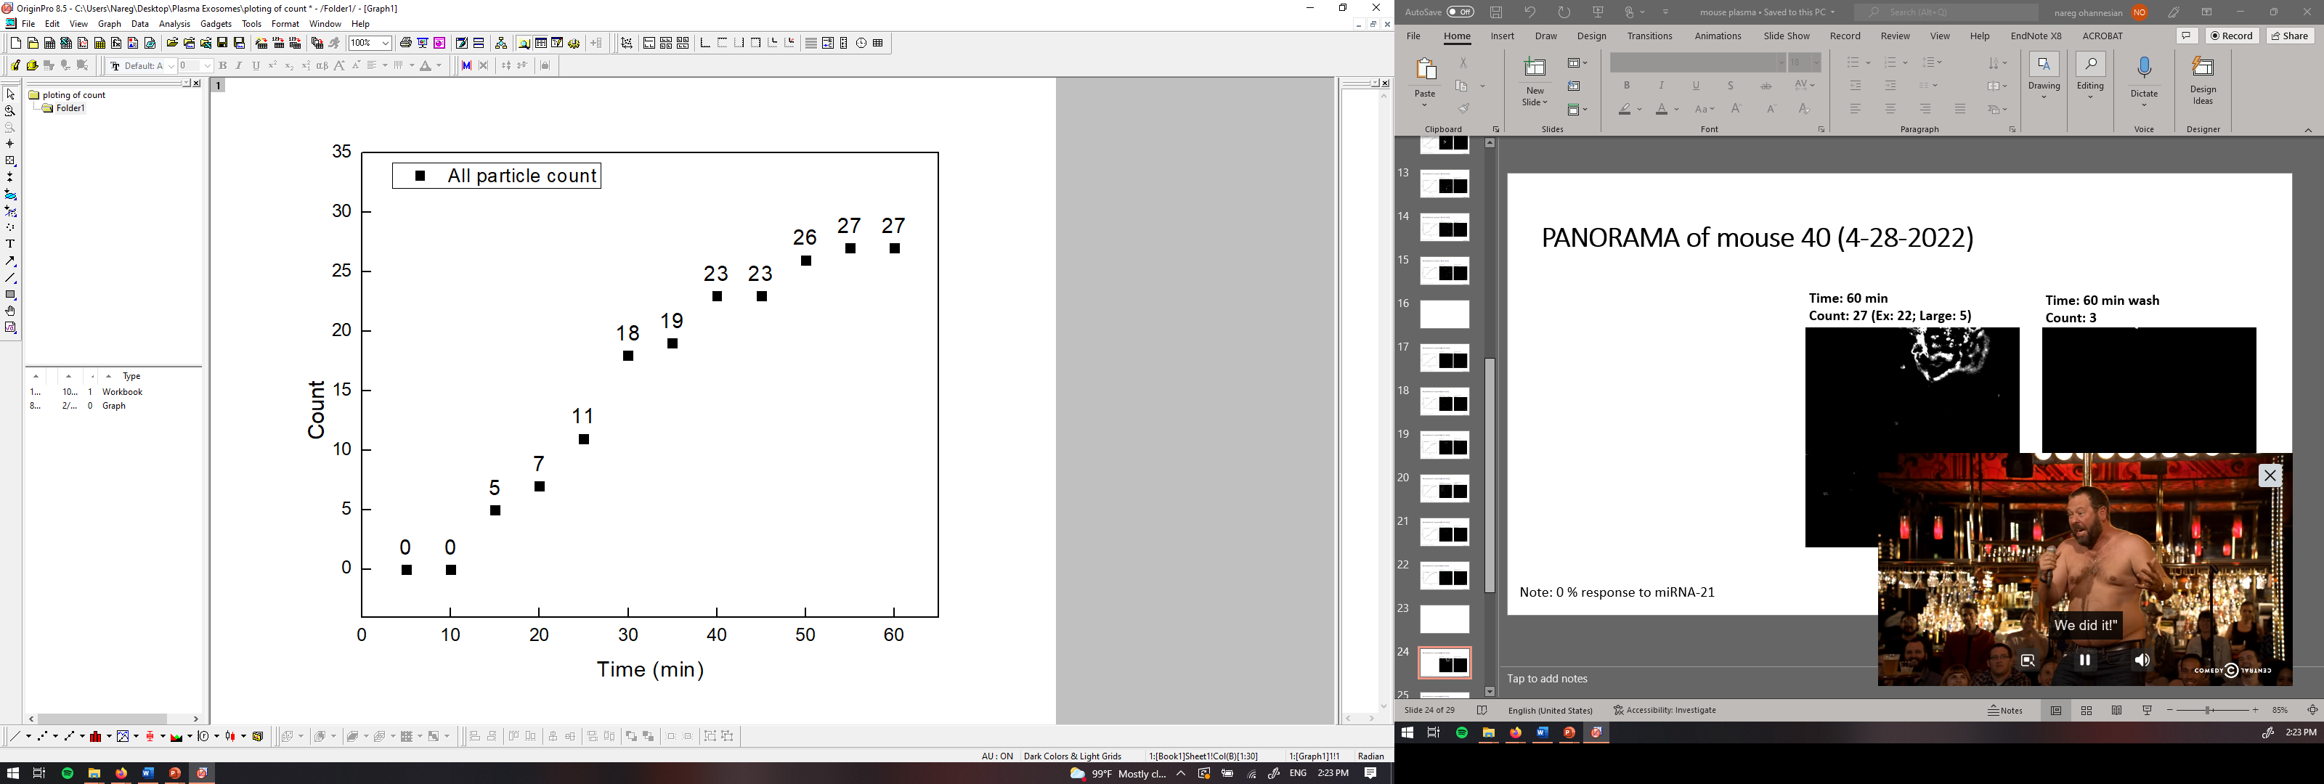
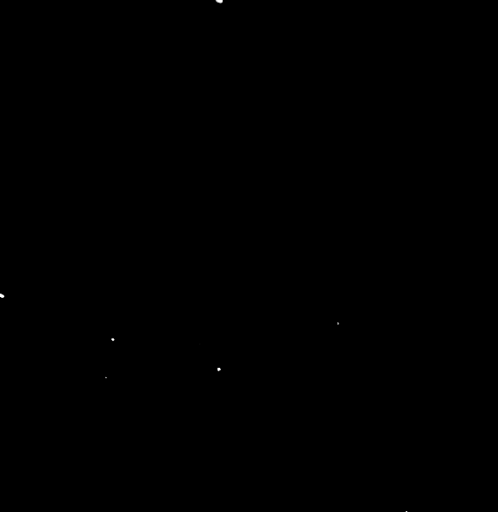
PANORAMA of mouse 40 (4-28-2022)
Time: 60 min
Count: 27 (Ex: 22; Large: 5)
Time: 60 min wash
Count: 3
Note: 0 % response to miRNA-21
Scale bar: 10 µm

Slide 2
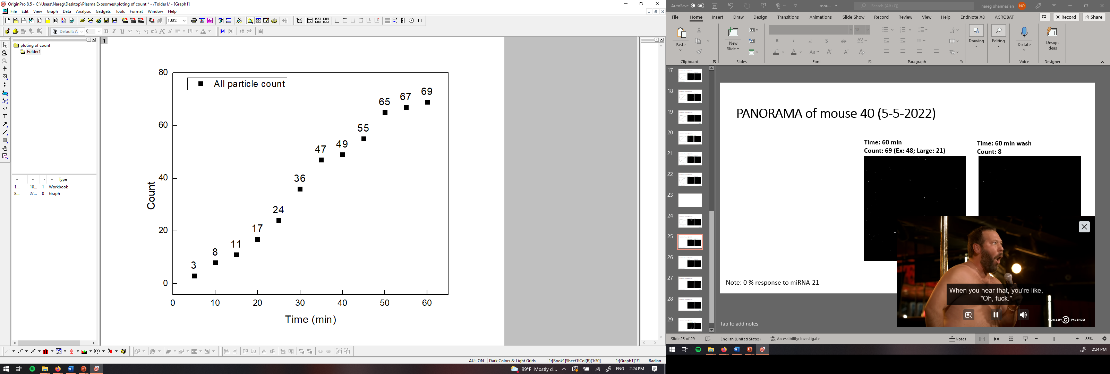
PANORAMA of mouse 40 (5-5-2022)
Time: 60 min
Count: 69 (Ex: 48; Large: 21)
Time: 60 min wash
Count: 8
Note: 0 % response to miRNA-21
Scale bar: 10 µm

Slide 3


PANORAMA of mouse 40 (5-12-2022)
Time: 60 min
Count: 97 (Ex: 69; Large: 28)
Time: 60 min wash
Count: 26
Note: 0 % response to miRNA-21
Scale bar: 10 µm

Slide 4
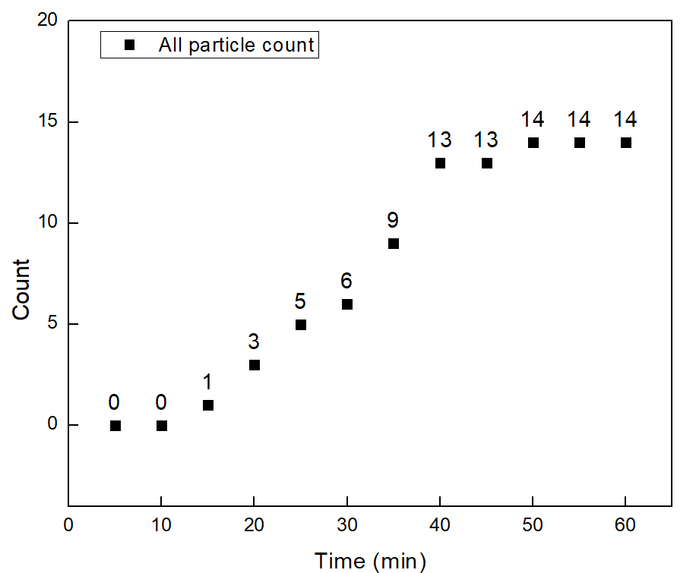


PANORAMA of mouse 40 (5-19-2022)
Time: 60 min
Count: 14 (Ex: 13; Large: 1)
Time: 60 min wash
Count: 1
Note: 0 % response to miRNA-21
Scale bar: 10 µm

Slide 5

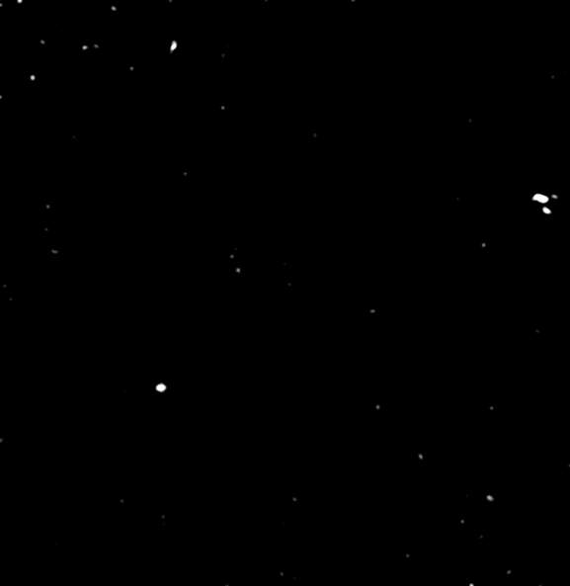

PANORAMA of mouse 40 (5-28-2022)
Time: 60 min
Count: 40 (Ex: 35; Large: 5)
Time: 60 min wash
Count: 7
Note: 0 % response to miRNA-21
Scale bar: 10 µm

Slide 6

PANORAMA of mouse 40 (6-5-2022)
Time: 60 min
Count: 342 (Ex: 67; Large: 285)
Time: 60 min wash
Count: 16
Note: 0 % response to miRNA-21
Scale bar: 10 µm

Slide 7
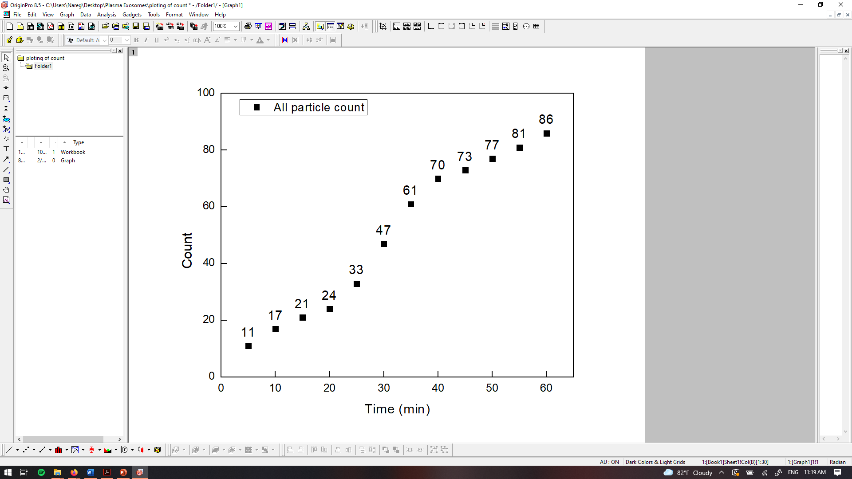
PANORAMA of mouse 41 (4-28-2022)
Time: 60 min
Count: 86 (Ex: 56; Large: 30)
Time: 60 min wash
Count: 32
Note: 0 % response to miRNA-21
Scale bar: 10 µm

Slide 8
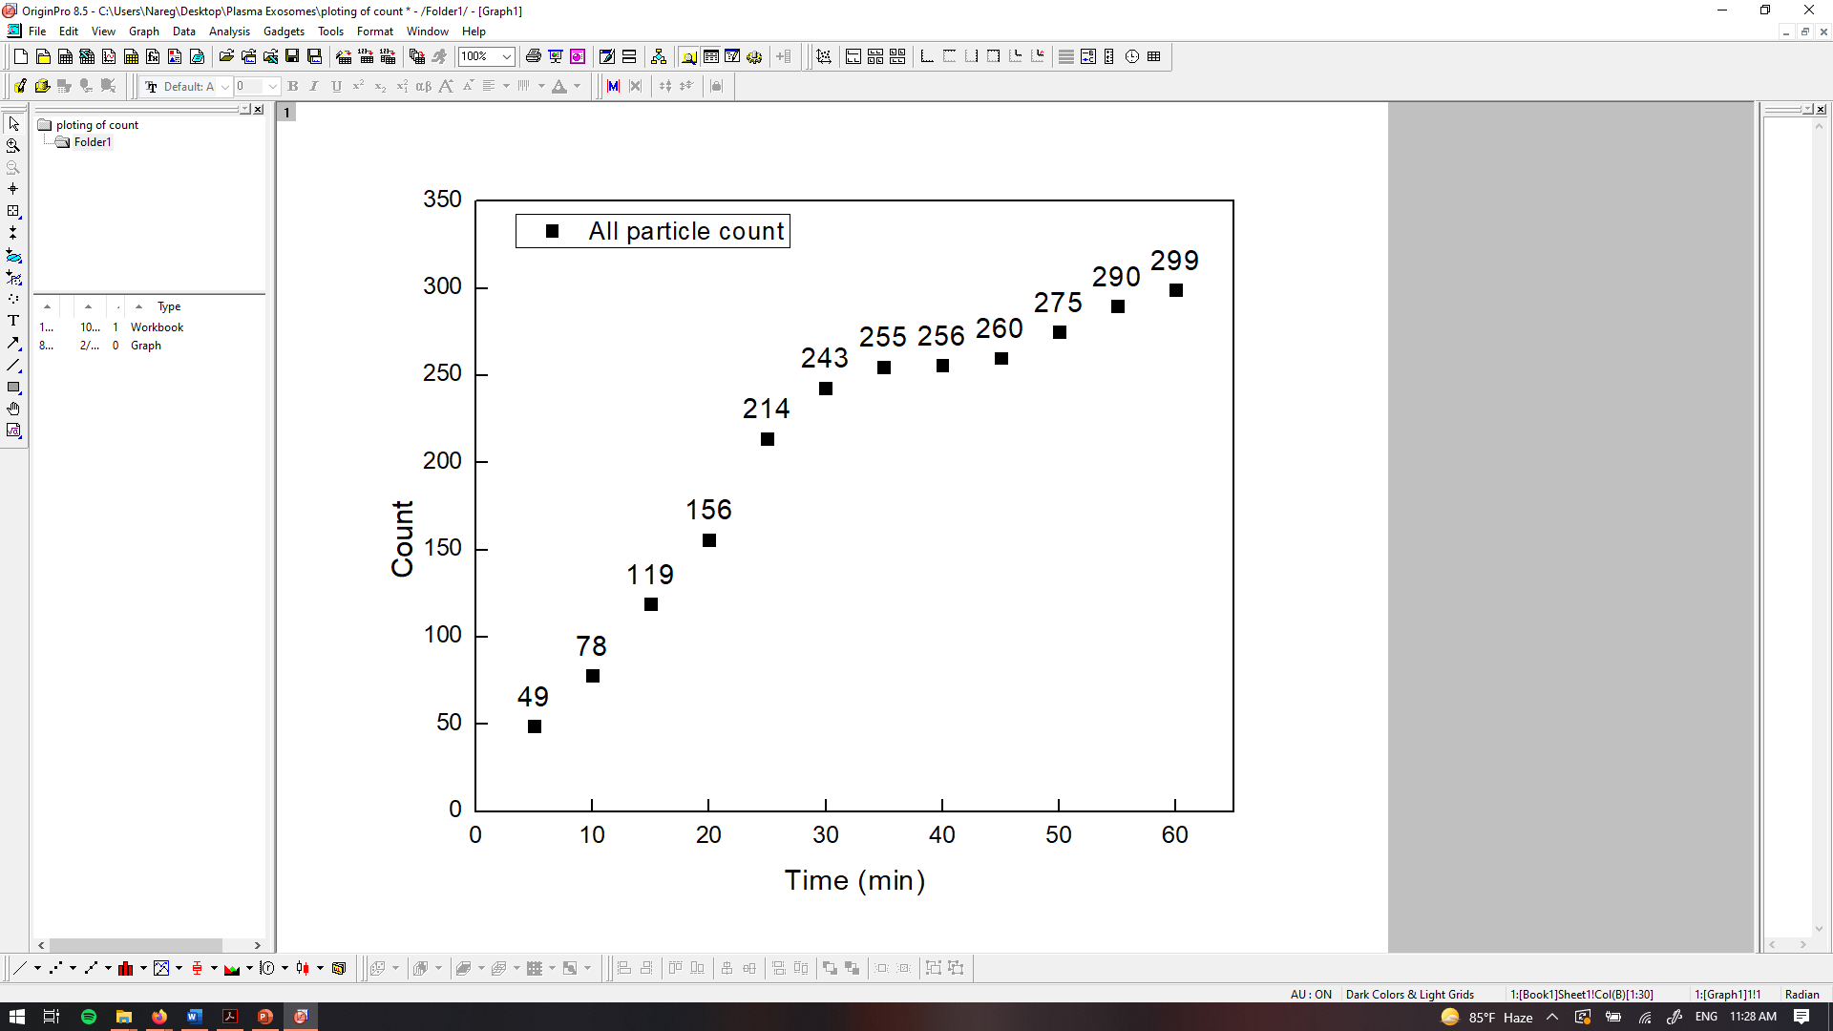

PANORAMA of mouse 41 (5-5-2022)
Time: 60 min
Count: 299 (Ex: 239; Large: 60)
Time: 60 min wash
Count: 65
Note: 0 % response to miRNA-21
Scale bar: 10 µm

Slide 9
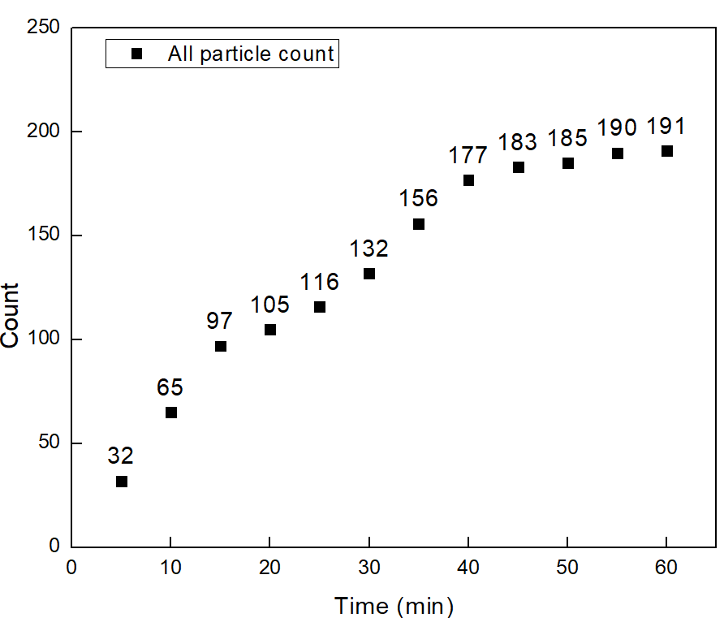
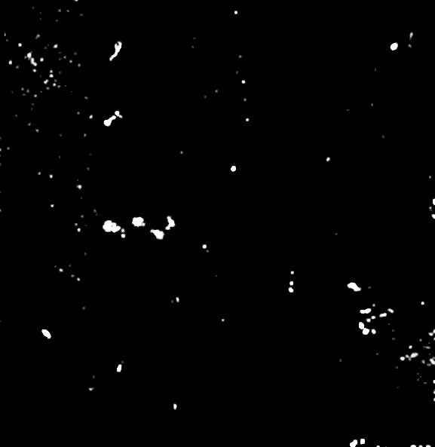

PANORAMA of mouse 41 (5-12-2022)
Time: 60 min
Count: 191 (Ex: 162; Large: 29)
Time: 60 min wash
Count: 93
Note: 29 % response to miRNA-21
Scale bar: 10 µm

Slide 10

PANORAMA of mouse 41 (5-19-2022)
Time: 60 min
Count: 319 (Ex: 236; Large: 83)
Time: 60 min wash
Count: 105
Note: 45 % response to miRNA-21
Scale bar: 10 µm

Slide 11
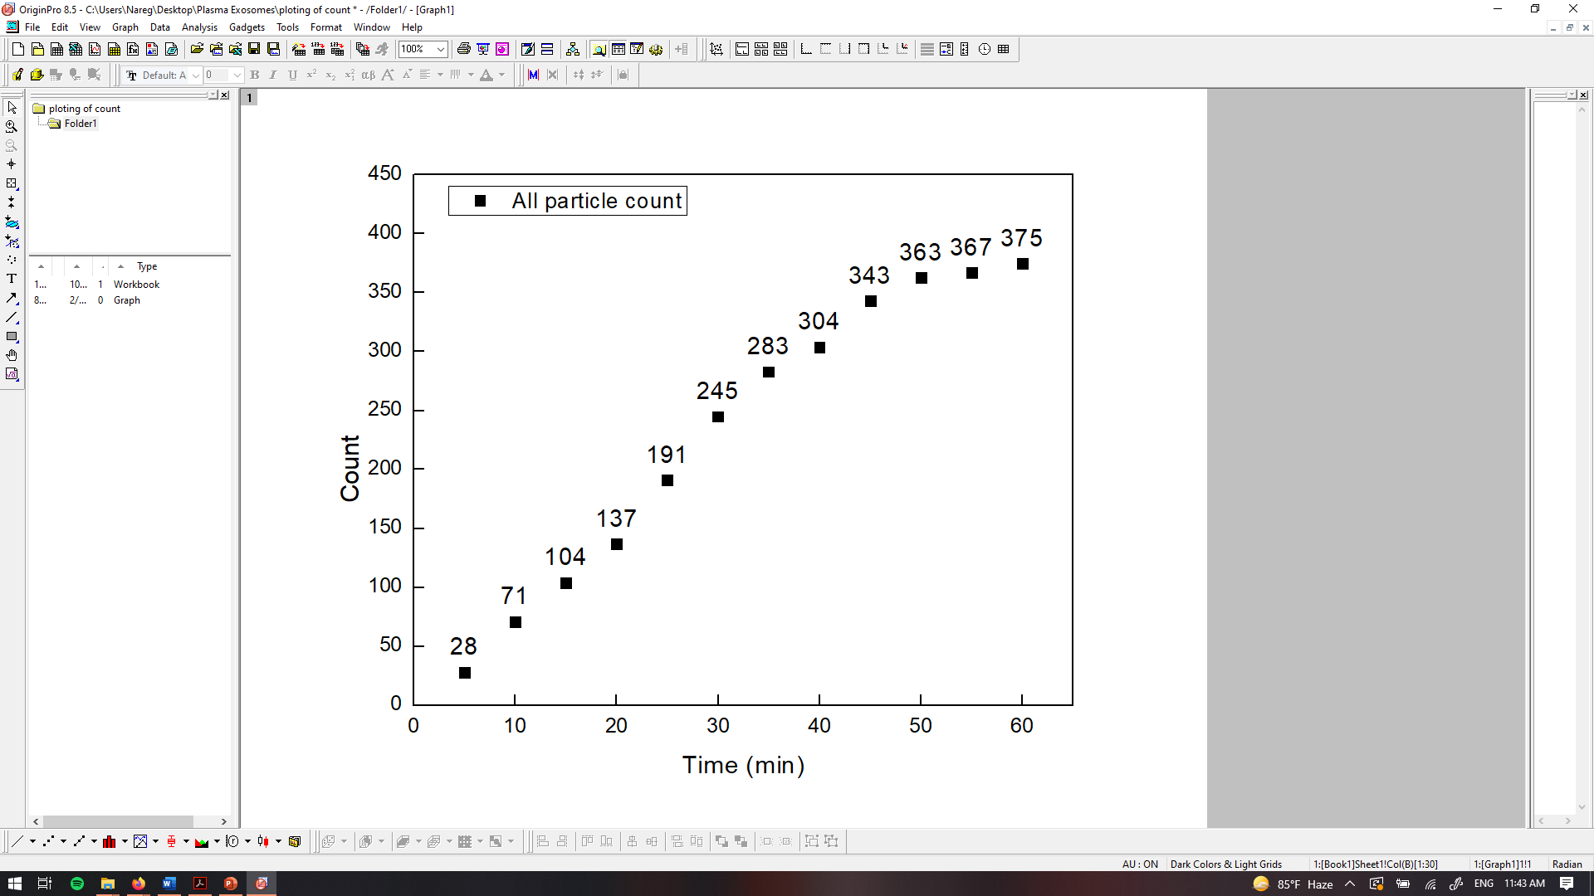
PANORAMA of mouse 41 (5-28-2022)
Time: 60 min
Count: 375 (Ex: 276; Large: 99)
Time: 60 min wash
Count: 133
Note: 41.3 % response to miRNA-21
Scale bar: 10 µm

Slide 12
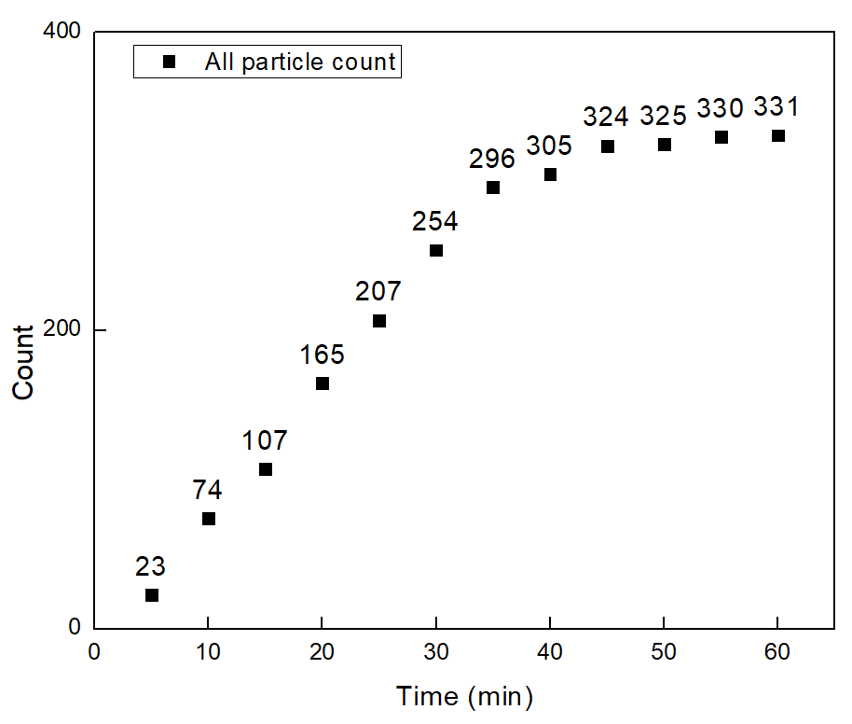


PANORAMA of mouse 41 (6-5-2022)
Time: 60 min
Count: 331 (Ex: 304; Large: 27)
Time: 60 min wash
Count: 130
Note: 39 % response to miRNA-21
Scale bar: 10 µm

Slide 13
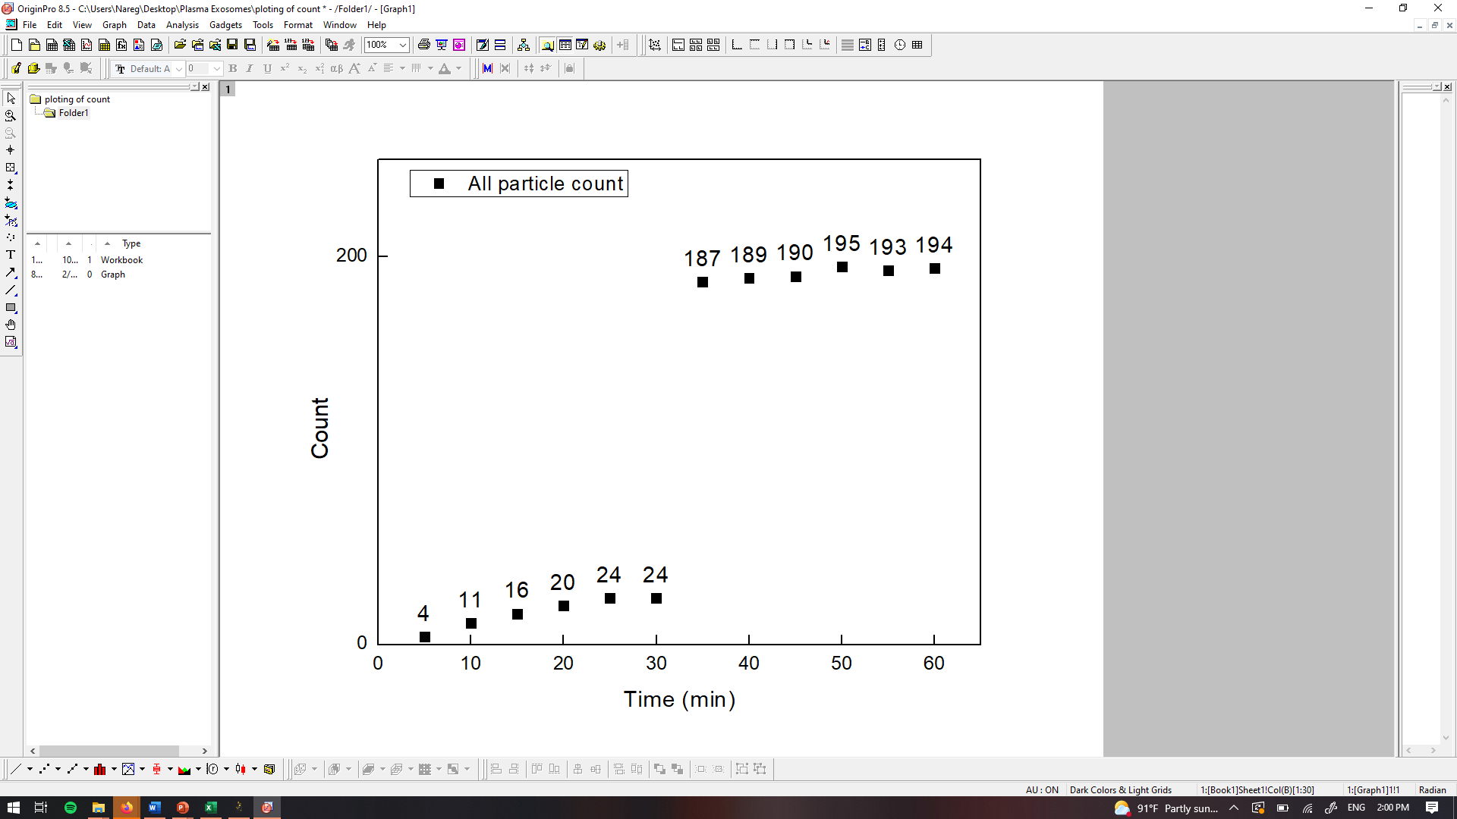
PANORAMA of mouse 42 (4-28-2022)
Time: 60 min
Count: 194 (Ex: 56; Large: 138)
Time: 60 min wash
Count: 21
Note: 0 % response to miRNA-21
Scale bar: 10 µm

Slide 14
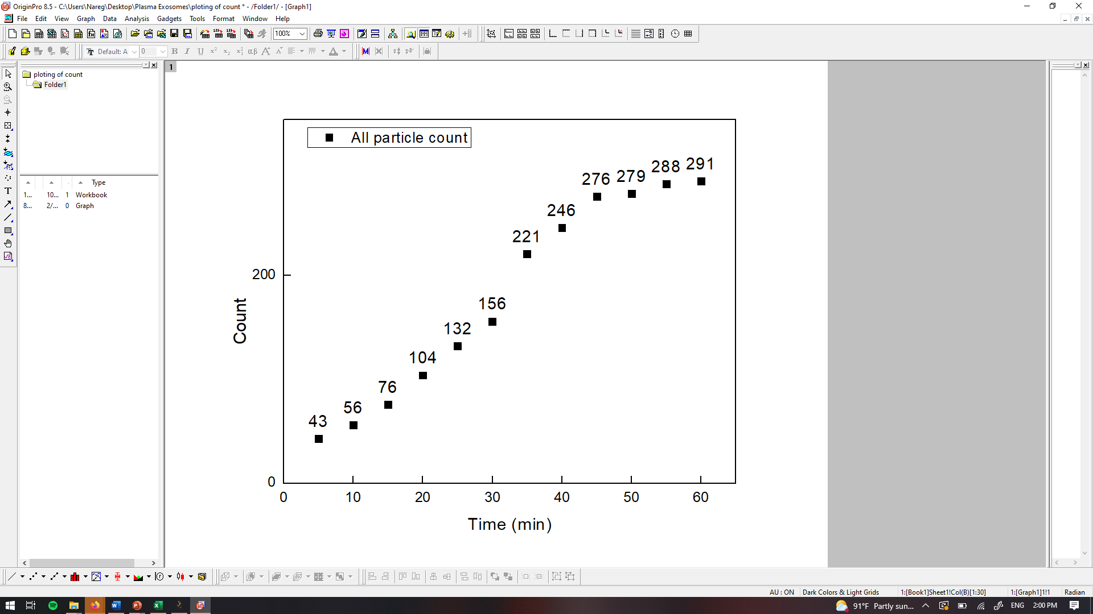
PANORAMA of mouse 42 (5-5-2022)
Time: 60 min
Count: 291 (Ex: 195; Large: 96)
Time: 60 min wash
Count: 85
Note: 0 % response to miRNA-21
Scale bar: 10 µm

Slide 15
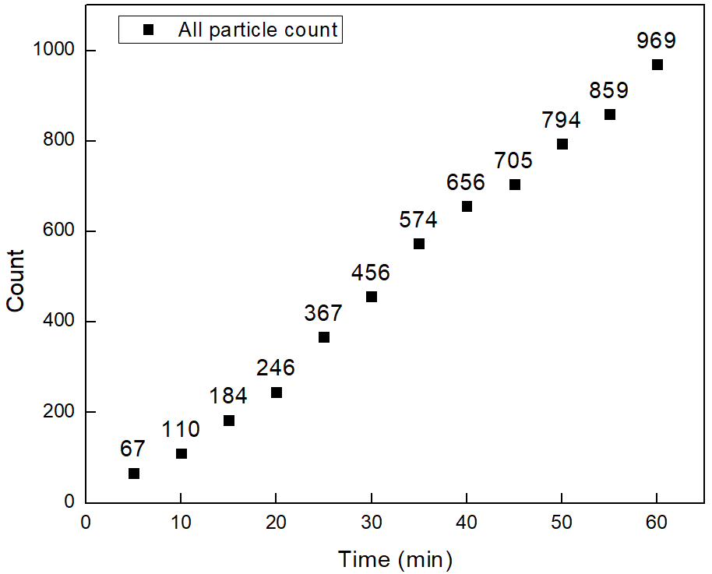


PANORAMA of mouse 42 (5-12-2022)
Time: 60 min
Count: 969 (Ex: 773; Large: 196)
Time: 60 min wash
Count: 353
Note: 56% response to miRNA-21
Scale bar: 10 µm

Slide 16
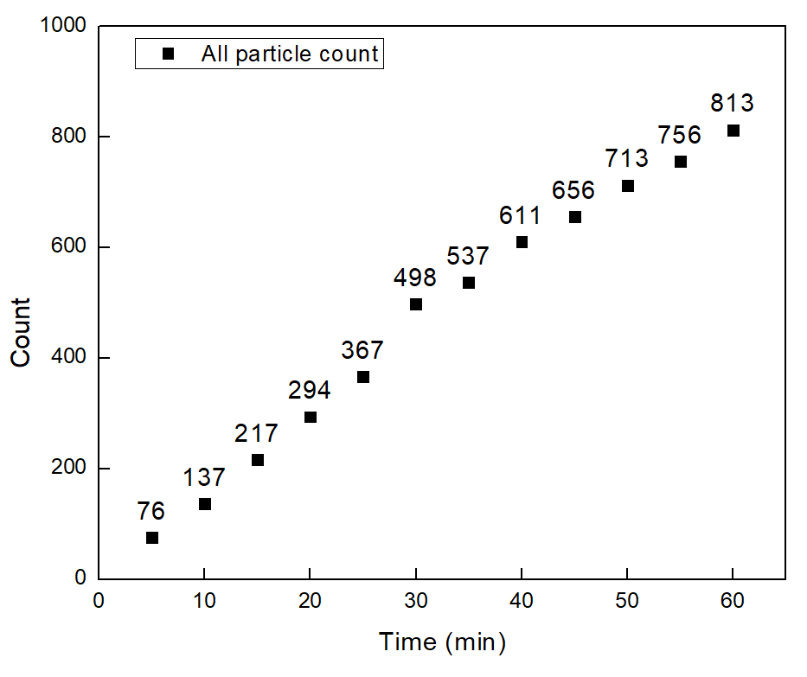
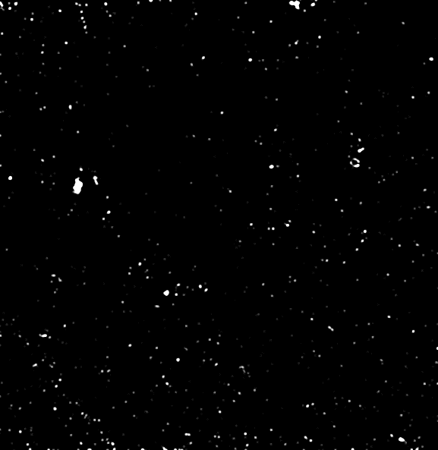

PANORAMA of mouse 42 (5-19-2022)
Time: 60 min
Count: 813 (Ex: 698; Large: 115)
Time: 60 min wash
Count: 285
Note: 38.5 % response to miRNA-21
Scale bar: 10 µm

Slide 17
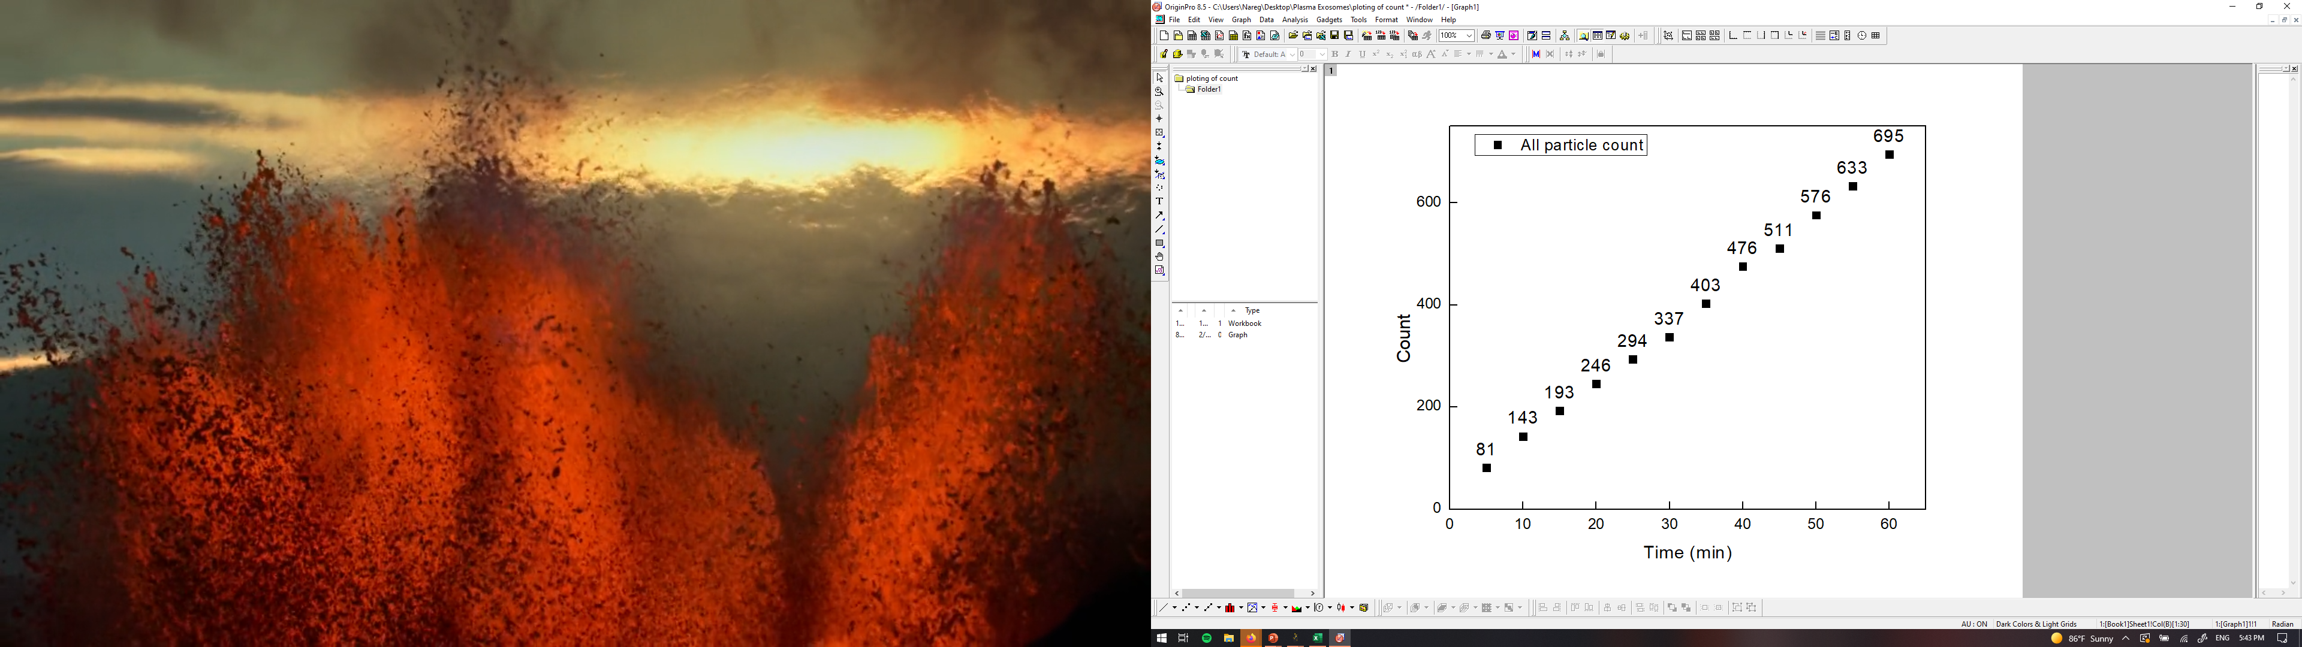
PANORAMA of mouse 42 (5-28-2022)
Time: 60 min
Count: 695 (Ex: 556; Large: 139)
Time: 60 min wash
Count: 263
Note: 41 % response to miRNA-21
Scale bar: 10 µm

Slide 18
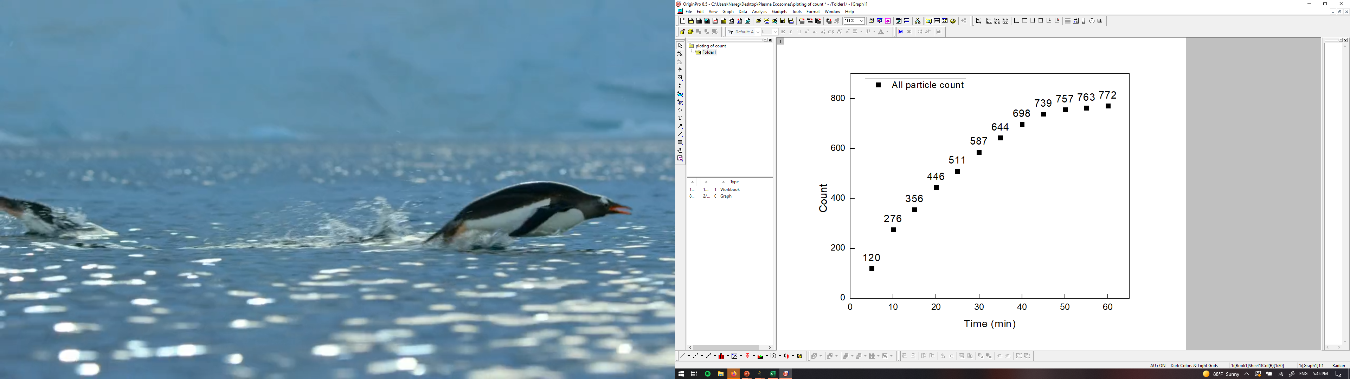
PANORAMA of mouse 42 (6-5-2022)
Time: 60 min
Count: 772 (Ex: 608; Large: 164)
Time: 60 min wash
Count: 276
Note: 46 % response to miRNA-21
Scale bar: 10 µm

Slide 19
Summary of all particles detected

Slide 20
Summary of retained exosomes and MIR-21 occurrence

Slide 21
Sample | Time | All | Large | Exosomes | Retained | MIR-21
36 | 4/28/2022 | 193 | 79 | 114 | 15 | 0
 | 5/5/2022 | 360 | 164 | 196 | 109 | 35
 | 5/12/2022 | 404 | 131 | 273 | 116 | 40
 | 5/19/2022 | 378 | 68 | 310 | 147 | 39
 | 5/26/2022 | 587 | 183 | 404 | 161 | 43
 | 6/2/2022 | 545 | 131 | 414 | 167 | 45
37 | 4/28/2022 | 67 | 12 | 55 | 4 | 0
 | 5/5/2022 | 237 | 129 | 108 | 52 | 27.5
 | 5/12/2022 | 287 | 50 | 237 | 75 | 46
 | 5/19/2022 | 408 | 125 | 283 | 92 | 33.7
 | 5/26/2022 | 470 | 200 | 270 | 100 | 59.5
 | 6/2/2022 | 539 | 104 | 545 | 109 | 48
39 | 4/28/2022 | 48 | 20 | 28 | 3 | 0
 | 5/5/2022 | 214 | 87 | 127 | 53 | 0
 | 5/12/2022 | 271 | 24 | 136 | 93 | 23
 | 5/19/2022 | 445 | 107 | 226 | 84 | 41
 | 5/26/2022 | 289 | 85 | 204 | 188 | 39
 | 6/2/2022 | 363 | 24 | 339 | 123 | 54
40 | 4/28/2022 | 27 | 5 | 22 | 3 | 0
 | 5/5/2022 | 69 | 21 | 48 | 8 | 0
 | 5/12/2022 | 97 | 28 | 69 | 26 | 0
 | 5/19/2022 | 14 | 1 | 13 | 1 | 0
 | 5/26/2022 | 40 | 5 | 35 | 7 | 0
 | 6/2/2022 | 342 | 285 | 37 | 16 | 0
41 | 4/28/2022 | 86 | 30 | 56 | 32 | 0
 | 5/5/2022 | 299 | 60 | 239 | 65 | 0
 | 5/12/2022 | 191 | 29 | 162 | 93 | 29
 | 5/19/2022 | 319 | 93 | 236 | 105 | 45
 | 5/26/2022 | 375 | 99 | 276 | 133 | 41.3
 | 6/2/2022 | 331 | 27 | 304 | 130 | 39
42 | 4/28/2022 | 194 | 138 | 56 | 21 | 0
 | 5/5/2022 | 291 | 96 | 195 | 85 | 0
 | 5/12/2022 | 969 | 196 | 773 | 353 | 56
 | 5/19/2022 | 813 | 115 | 698 | 285 | 38.5
 | 5/26/2022 | 695 | 139 | 556 | 263 | 41
 | 6/2/2022 | 772 | 164 | 608 | 276 | 46

